Slide 1

NC Census Employment Data analysis
Project Team:
Eunjeong Lee, Bill Pezzullo, Abby Pearson, Teshanee, Niral Patel

Slide 2
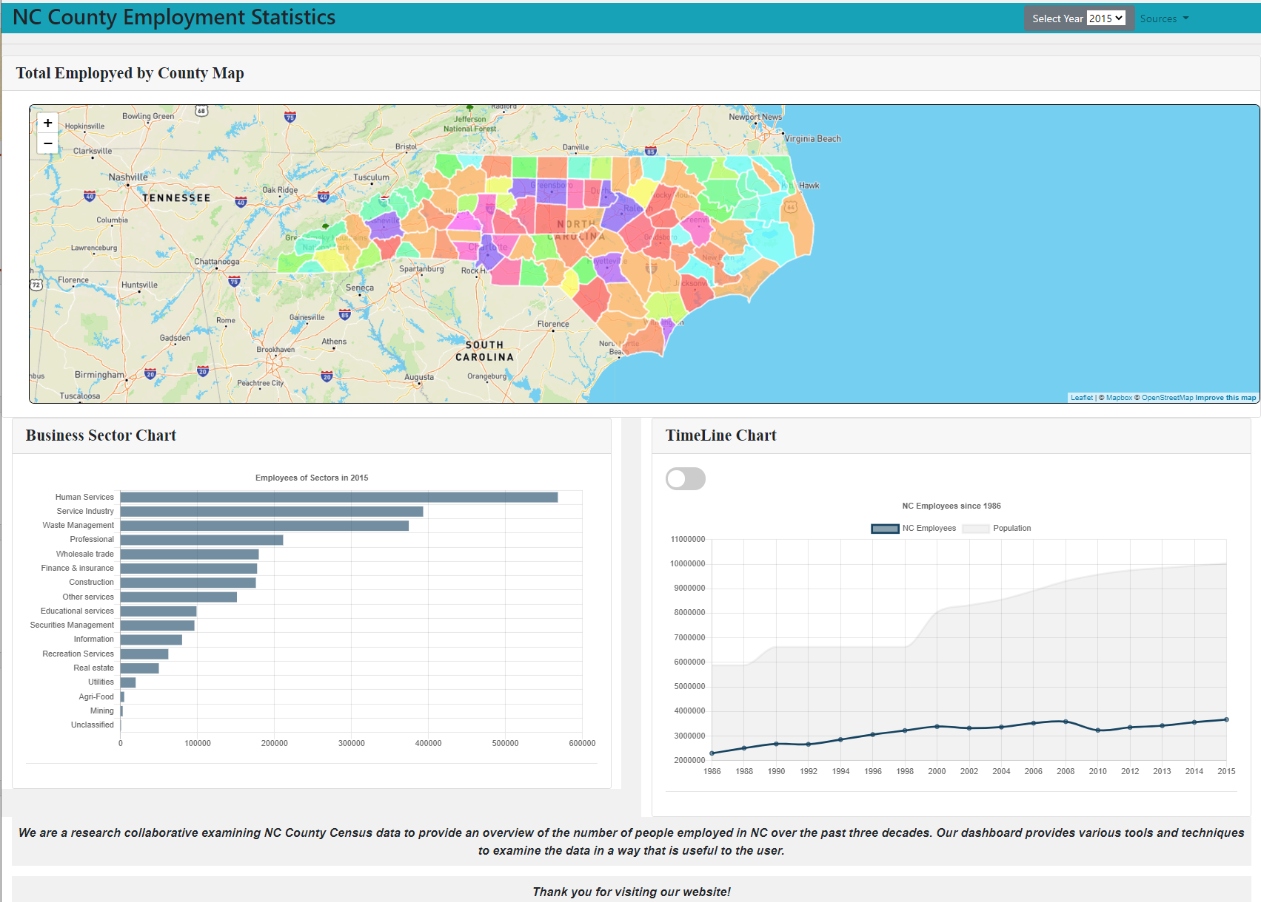
Product Introduction
Show the working site
Explain all features on the site
Data visualization information

Slide 3
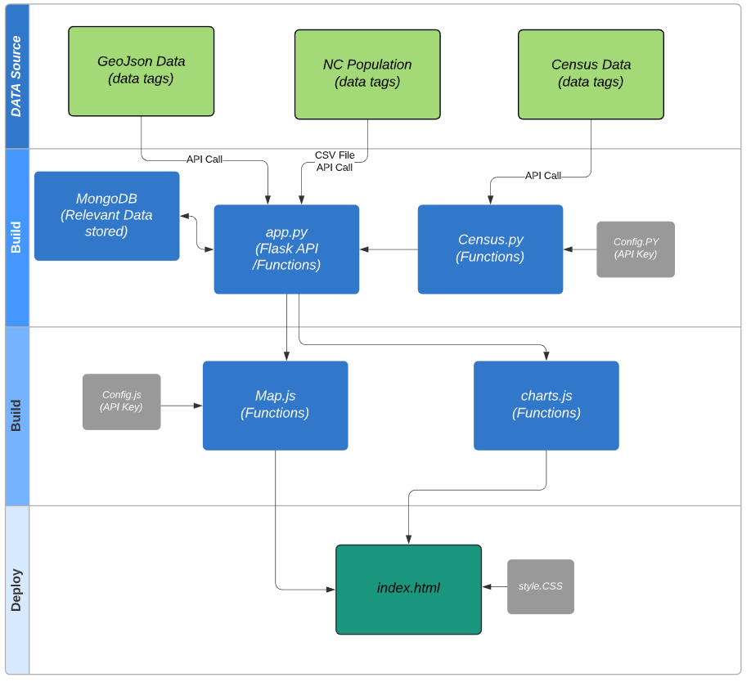
High Level Data Flow
Database:
MongoDB
Front-End Technology:
Chart.js
Mapbox
D3
Leaflet
Flasks
HTML
Bootstrap
Notes:
Three main phase
Data sources
Build (Python, Java & HTML)
Deploy

Slide 4
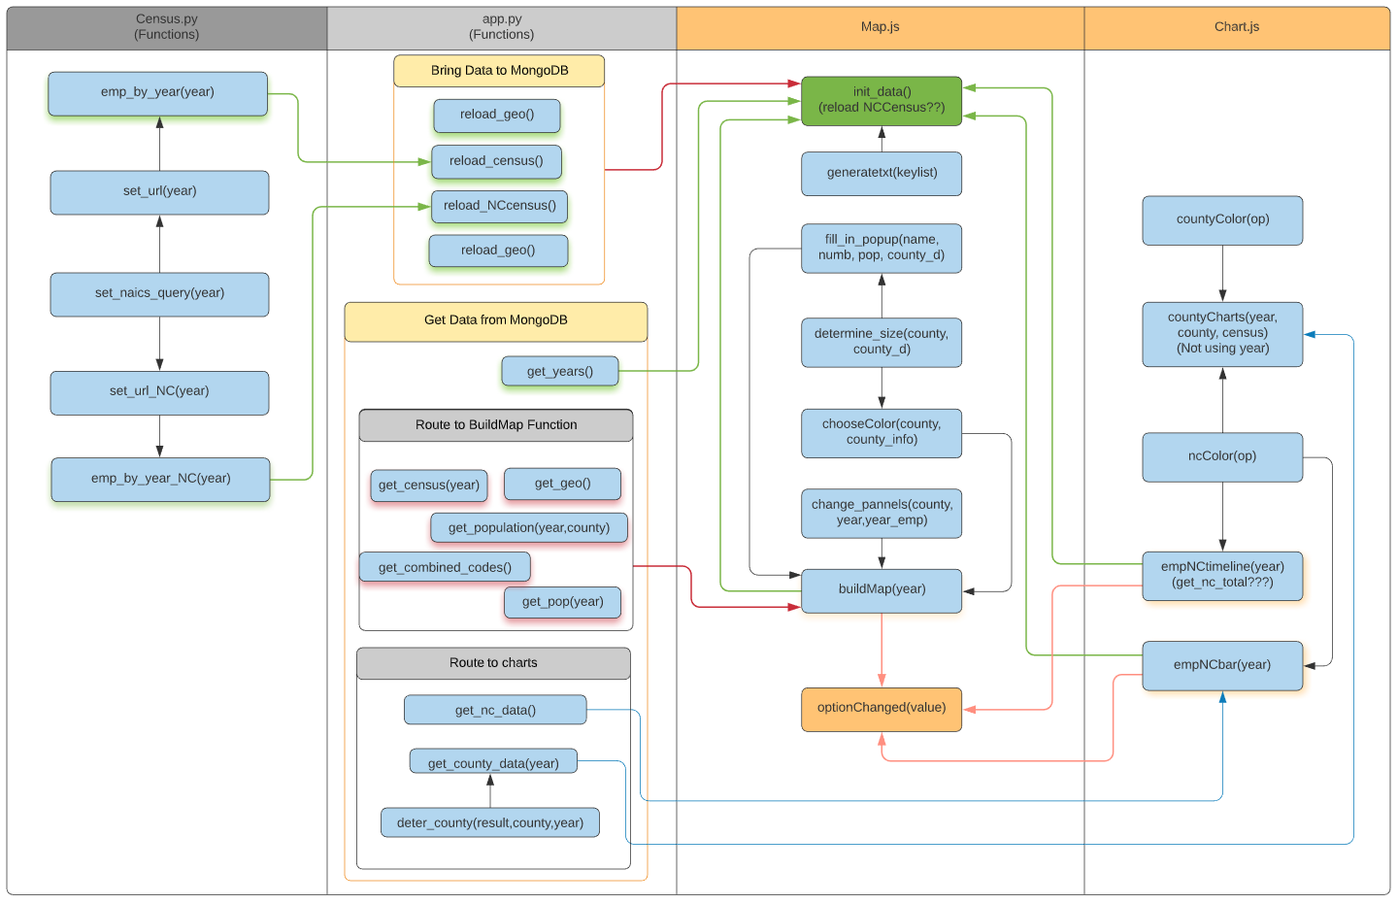
Function Flow Diagram

Slide 5
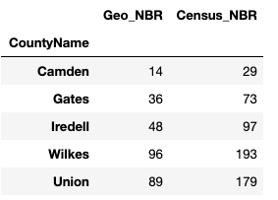
Data Collection
MongoDB: censusdb
Collection: census
1986 | 1988 | 1990 | 1992 | 1994 | 1996 | 1998 | 2000 | 2002 | 2004 | 2006 | 2008 | 2010 | 2012 | 2013 | 2014 | 2015 | 2016 | 2017 | 2018
CBP: Total EMP
Query variables for API call:
GEO_TTL, EMP
CBP: Total EMP
NAICS1997_TTL,
GEO_TTL,
EMP
CBP: Total EMP
NAICS2002_TTL,
GEO_TTL,EMP
CBP: Total EMP
NAICS2007_TTL,
GEO_TTL,
EMP
County Business Patterns(CBP):
Business Sectors EMP
GEO_TTL,
EMP
CBP: Business Sectors EMP
NAME,
EMP
MongoDB: censusdb
Collection: nccensus
County Codes(Number) – json file
CBP: State-wide EMP
CBP: State-wide EMP
CBP: State-wide EMP
CBP: State-wide EMP
CBP:
State-wide Business Sectors EMP
CBP: State-wide Business Sectors EMP
CSV file
Population: 1980, 1990, 2000 census results
Source: NC census demographic data
Population: 2001~ 2009
Source: Population Estimate Program of Census.gov
Population: Annual County Population
Source: NC OSBM demographic table

Slide 6
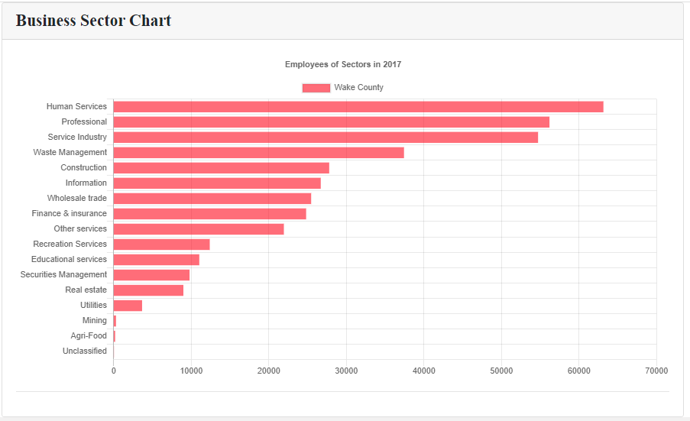
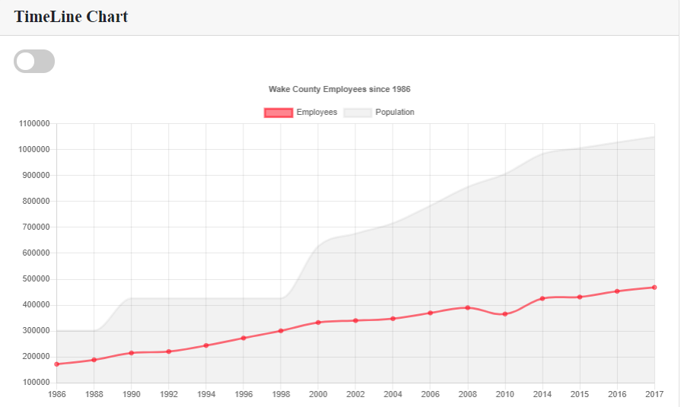
Summary
NC county Census employment data analysis for multiple years.
This dashboard provides visibly into the population and employment data for selected year. The map provides more data visibility into each county.
User have option to drill down into the data per county
The timeline chart can be stacked against county population to identify population growth vs. employment.
Business sector chart shows employment industries from top down.
Notes:
Purpose of building this page
Speak to the dashboard in the summary
Explain some of the observation over various year data

Slide 7
Question?

Slide 8
APP Routes
Loading data to MongoDB (Initialize)
/reload_geo
/reload_census
/reload_nccensus
Get Map, County codes data
/get_geo", methods=["GET"])
/get_combined_codes
Get EMP data
/get_census/<year>"
/get_county_data/<county>
/get_nc_data/<year>
/get_nc_total/<year>
Get Population data
/get_population/<year>/<county>
/get_pop/<year>

